Slide 1
SARS-CoV-2 Gene Mutations across Various Geographic Regions
Jonathan , Jacqueline, Faneela, Gyaban

Slide 2
Background & Hypothesis
Investigation of genetic diversity of SARS-CoV-2 isolates from the USA and UK
3 genes analyzed
S - Spike Protein
N - Nucleocapsid
Nsp12 - RNA-dependent RNA polymerase
The frequency and distribution of gene mutations in the S, N, and nsp12 genes of SARS-CoV-2 isolates differ significantly between the US and UK, suggesting varying levels of genetic diversity among these regions.
Notes:
Jonathan

Slide 3
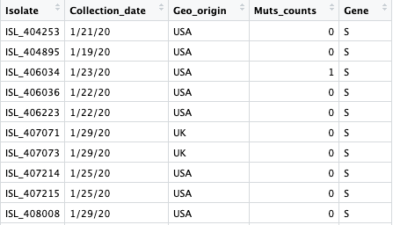
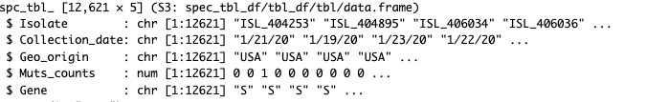
Dataset
The dataset lists 12621 observations of 5 variables
Isolate ID
Collection date (M-DD-YY)
Geographic origin (USA or UK)
Muts_counts
Gene
Notes:
Jacqueline + Jonathan + Gyaban
The dataset consists of 12,621 covid isolates that come from different geographic origins, as well as the date they were collected. Along with them is 1 of the 3 SARS-CoV-2 genes that the isolate had a mutation in. The dataset also provides the exact number of mutations found within the specific gene.
Each isolate was given an ID ex. ISL_404253
Isolates were collected over the course of 1 year (2020)
Isolates came from the US or the UK
The three SARS-CoV-2 genes that had a mutation were: S, N, and nsp12
The number of mutations found within the genes ranged from 0-8

Slide 4
Data Visualization Rationale
Null Hypothesis: There is no significant difference in the frequency and distribution of SARS-CoV-2 mutations across the USA & UK
ANOVA
α = 0.05
Violin plot
Combination of a box plot and density plot
Width of each curve corresponds to the approximate frequency of data points in each region
Violin plot to demonstrate how the frequency of isolates exhibiting a select number of mutations in one gene changes depending on geographic origin
Notes:
Jonathan + Jacqueline
If our hypothesis is true, the density curves should look different across the US and the UK.
Violin plots present a Distribution of data using density curves, with the
There are Thousands of isolates with mutation in 1 of 3 genes so Many of the isolates should be similar to one another -- because of this the violin plot will demonstrate how the frequency (read the rest of the last bullet point)

Slide 5
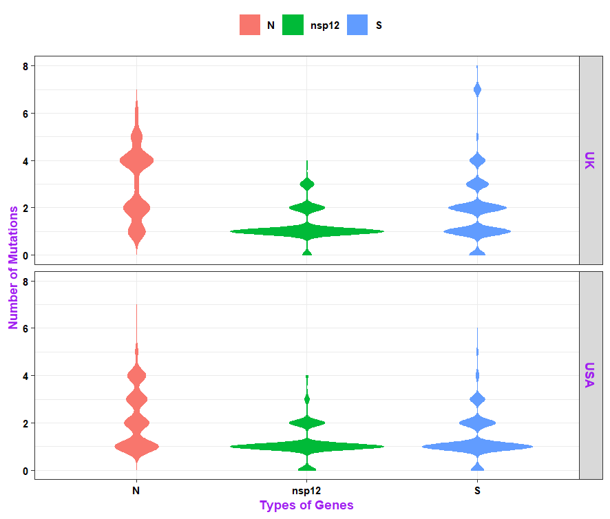
Figures
Figure 1. The wider areas correlate to the frequency of isolates that have that specific number of mutations in the gene
E.g. A large frequency of US isolates only had 1 mutation in the S gene
This can be observed by the widest density curve. Filtering the dataset can corroborate these findings
Notes:
Jacqueline + Jonathan

Slide 6
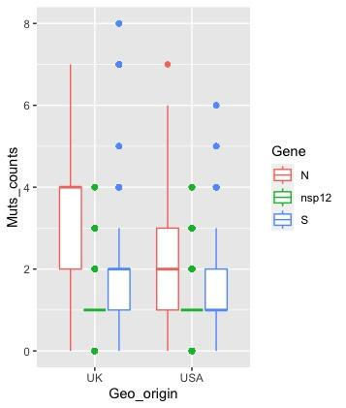
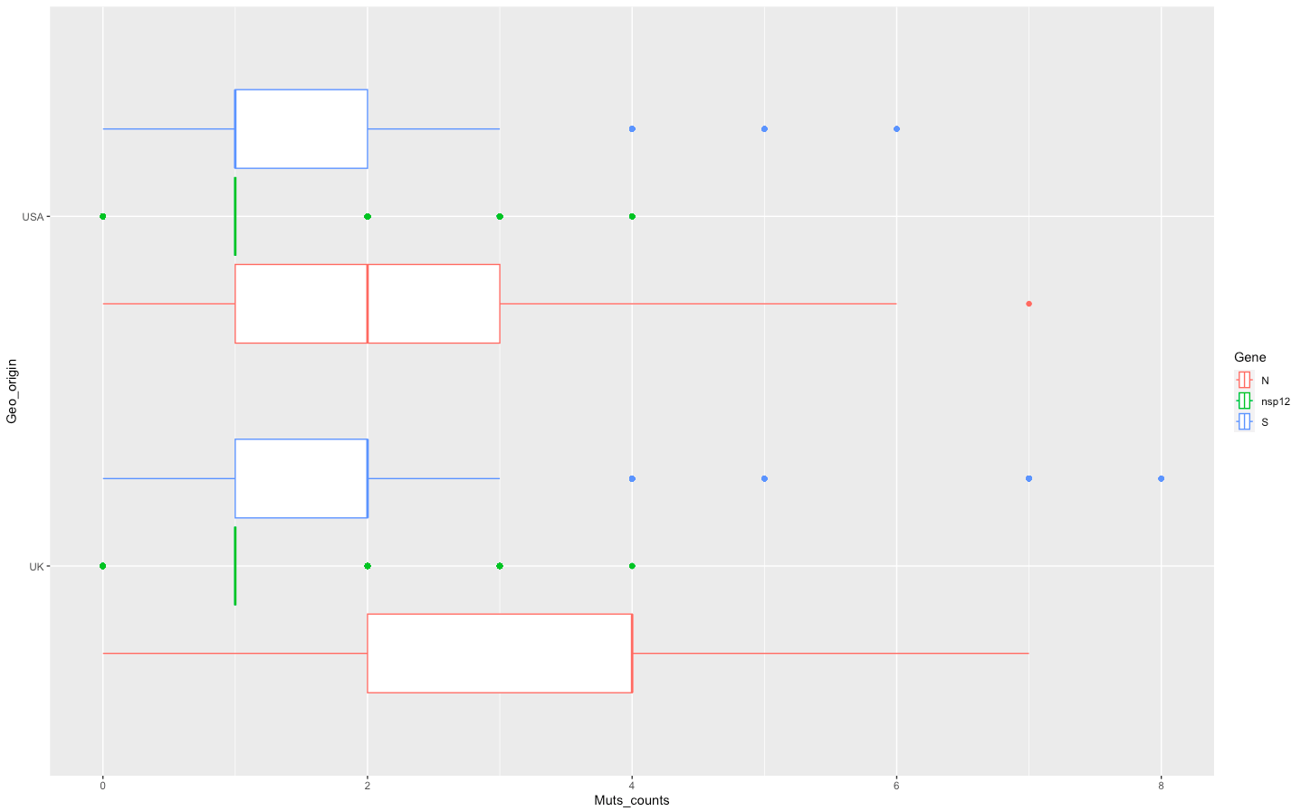
Figures
Boxplots compare the distribution of mutation counts for each geo origin
Contain a median, a lower quartile and an upper quartile.
Any values that fall outside whiskers are an extreme
Notes:
Gyaban

Slide 7
Statistical Analysis
What does the p value mean in terms of our hypothesis?
P value 2e-16
Evidence of a statistically significant difference between mutation count and geographic origin
Null hypothesis rejected in favor of alternate
There is a significant difference in the frequency and distribution of SARS-COV 2 mutations across the US and the UK regions
Notes:
Faneela + Jonathan

Slide 8
Results & Conclusion
From ANOVA...
Correlation exists as the statistical analysis rejects the null hypothesis and the p values is way less than the alpha of 0.05
We can conclude that the frequency and distribution of gene mutations in the S, N, and Nsp12 genes of SARS-CoV-2 isolates does differ significantly between the US and UK geographic regions
Notes:
Faneela

Slide 9
References
“SARS-COV-2 Conserved Domains and 3D Structures.” National Center for Biotechnology Information, U.S. National Library of Medicine, 2023, https://www.ncbi.nlm.nih.gov/Structure/SARS-CoV-2.html.
Notes:
Jacqueline + Jonathan

